Slide 1


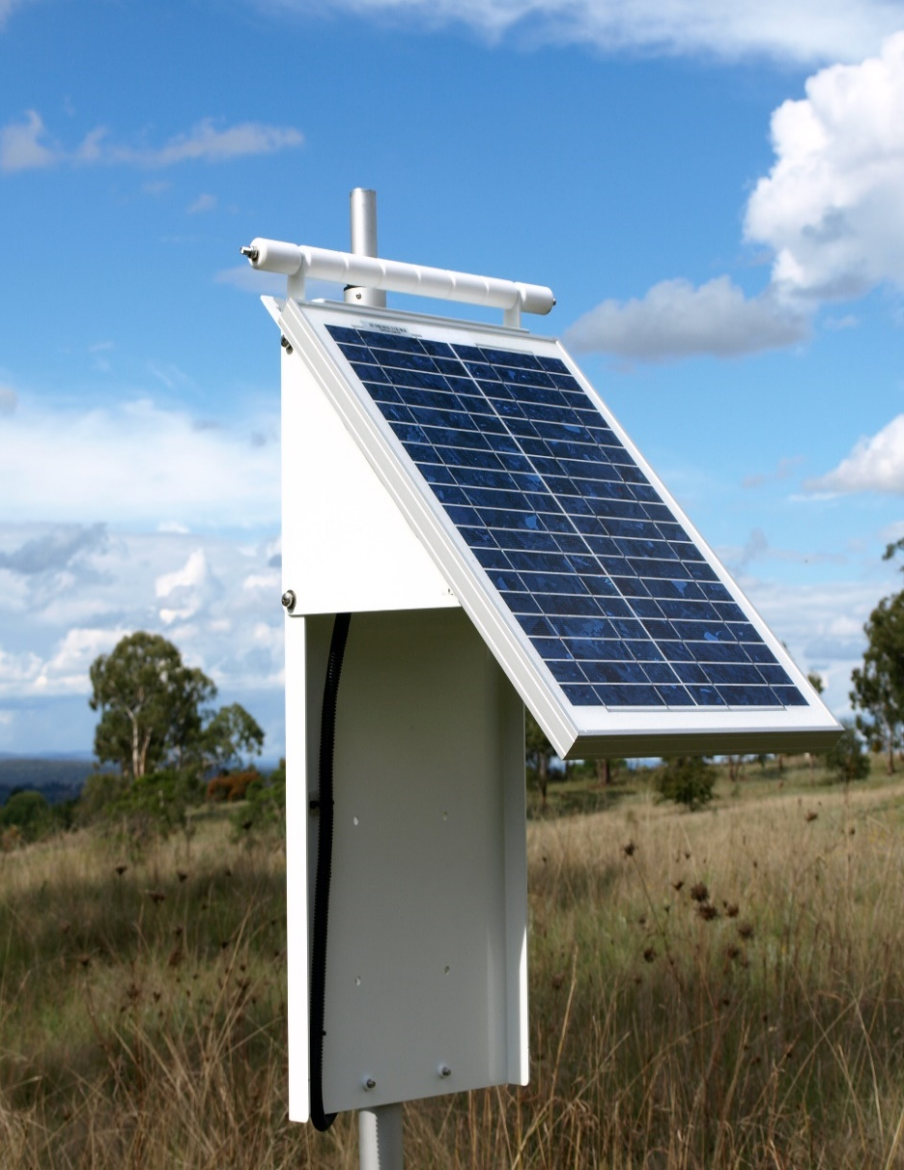
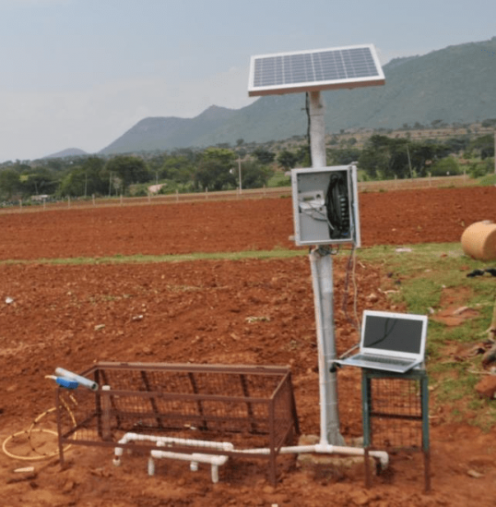
Crop Management using ML and IoT
PRAGYAN
Suitable Crop Recommendation
Resistive seed for existing disease
Predict Sowing and Harvesting Date
Disease Detection
Smart Irrigation
Crop Monitoring
Fertilizer, pesticide & insecticide
Storage and Disaster Management Remedies

Slide 2

Data Fetching
5. Data Processing
Processing and manipulation of furnished Data-set to achieve targets for omitting Crop loss using ML algorithms.
3. Real Time Data
Sensors of the device in the field providing parameters as real time data.
4. Soil Health Card
Linking of soil health card and collection the information about soil condition.
1. Installation and Activation
installation of device and activation of GPS for getting info about location of field.
2. Retrieving Data
Fetching pervious 10-15 years Data of Rain fall, temperature, weather conditions, crop yield and etc.

Slide 3




Recommendation system
Fertilizer
Using soil nutrients parameter or analysis and computation through ML model which in turns helps the farmers to cultivate and produce healthy crop.
Seed
Disease and pest resistive seed will be selected on the basic of pre-existing diseases in the soil and according to previous years data. That can be used to maintain and improve the quality of crop varieties
Crop
Considering previous years crop yield data, soil characteristics, soil type and suggest farmer the suitable crop based on farm specific parameters in order to get maximum yield and profit.

Slide 4
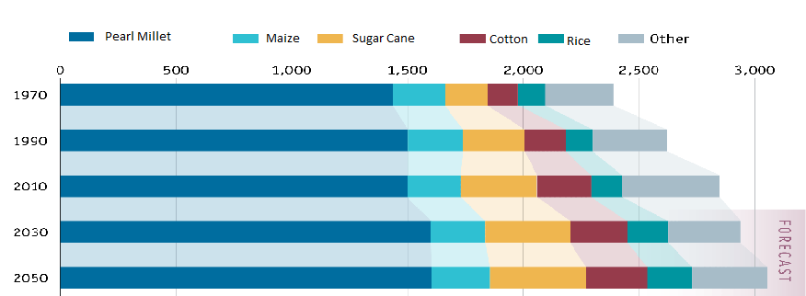
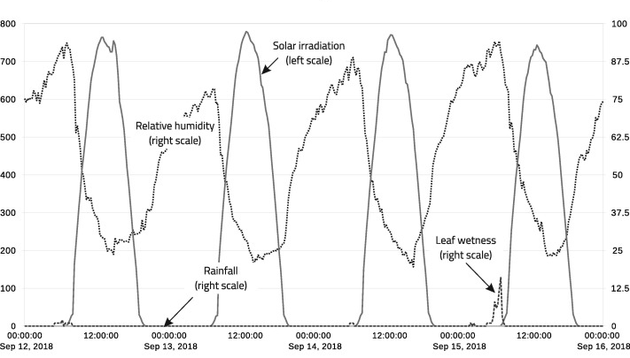
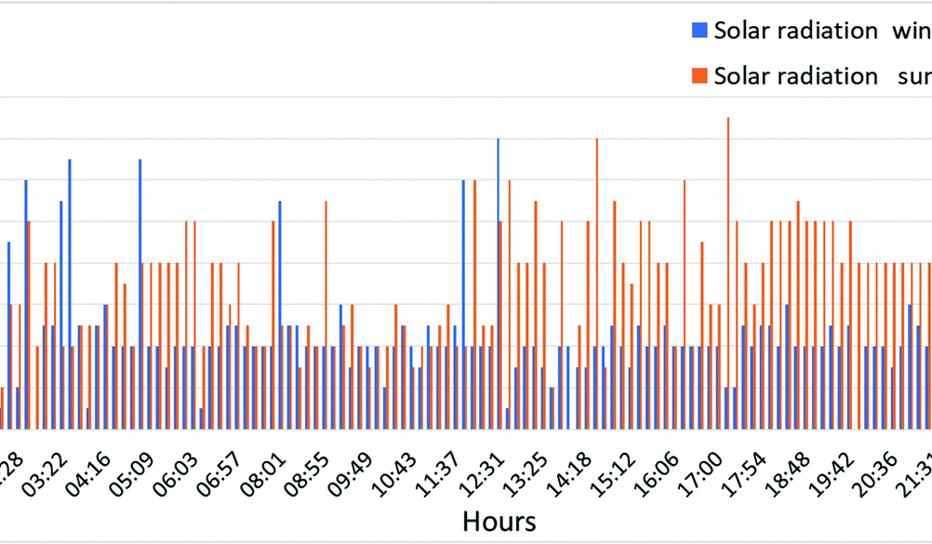
Yield Analysis and prediction
Crop Monitoring
The continues crop monitoring base on real time crop vegetation index Via. A camera module and sensors on the field will analysis the optimal conditions to get maximum crop productivity, saving farmer’s time and energy

Slide 5
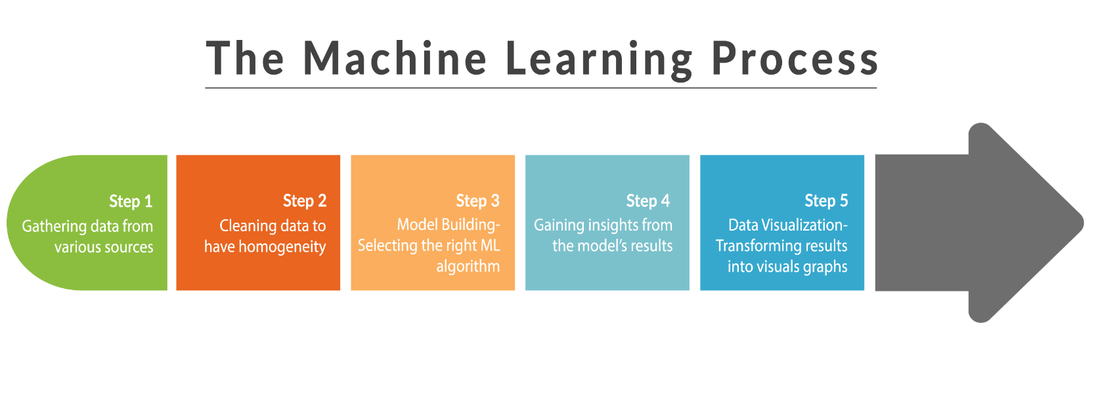
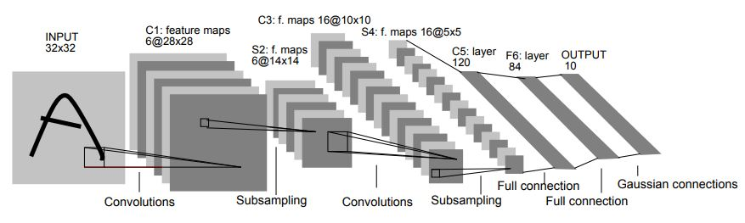
The Machine Learning Process

Slide 6

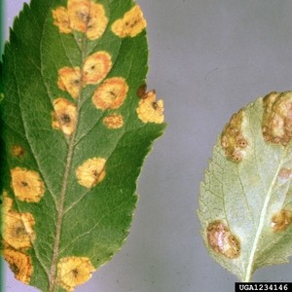
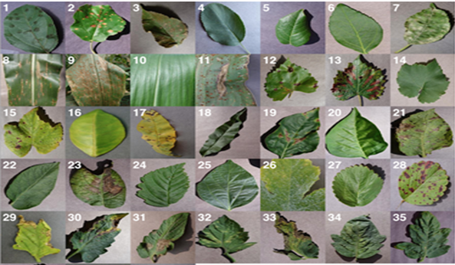
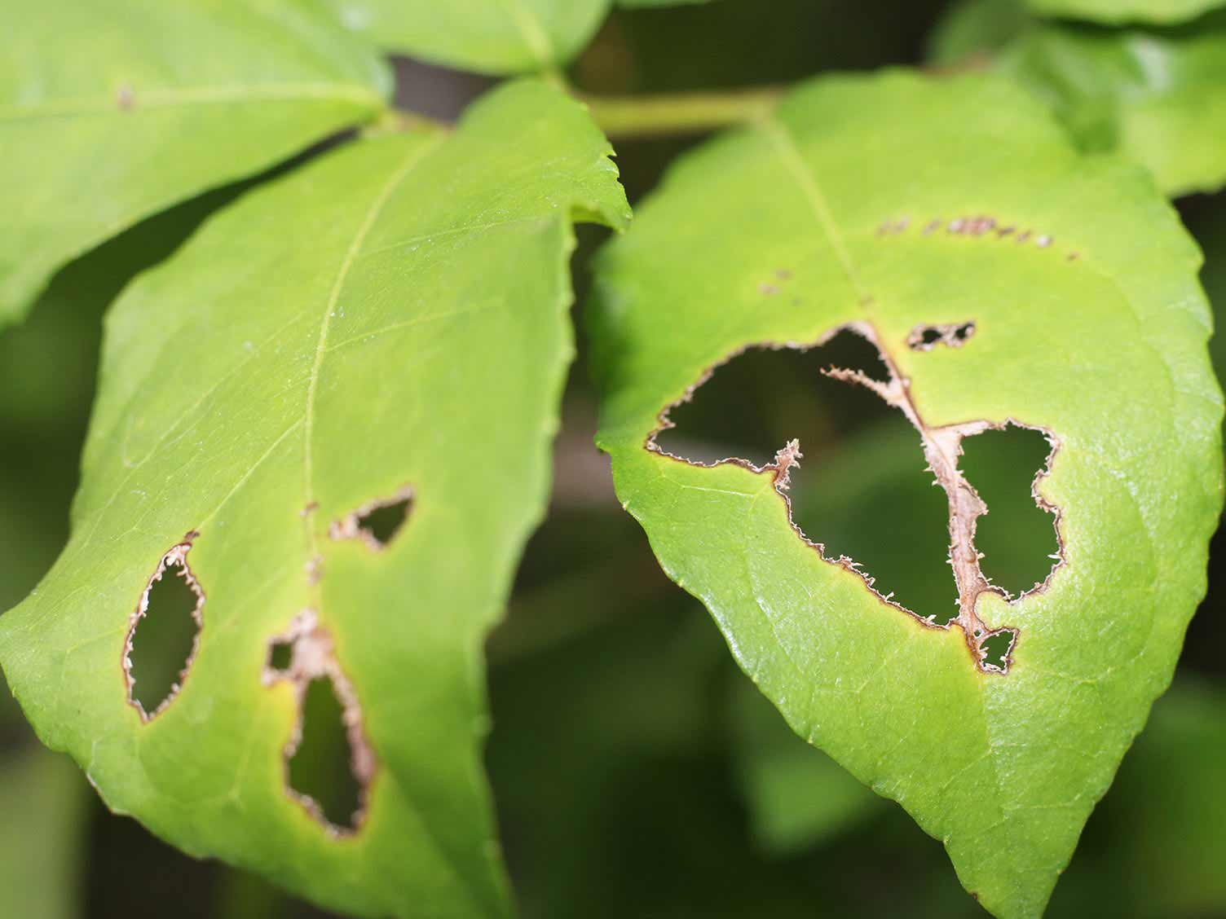
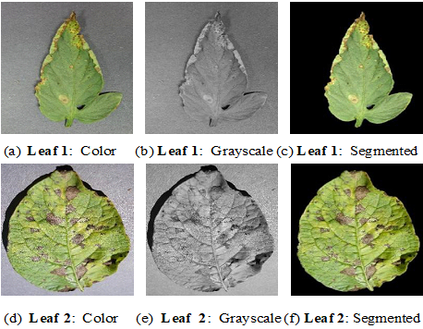
Disease detection
Our system helps in identification plant disease and pest on the basis of real time monitoring via camera module through CNN and Image proceeding will detect disease, pest and insect. Also provide Remedies for improving health and yield of the crop.

Slide 7






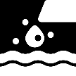


Smart Irrigation
Soil Temperature
The system monitor soil condition and weather forecast and other parameters
Humidity
Flow meter
Ensure sustainable and responsible irrigation over time.
Weather Forecast &
solar radiation
Fully automatic device , no requirement of man efforts
Temperature
Control amount of waste water.
Soil moisture
Leaf wetness
Enhancement in quality and quantity of crop
Automatically adjust better irrigation scheduling.
Water is used in effective way so other farmer can also take advantage of remaining water
Rain Fall

Slide 8
Other Features
Sowing Date
Harvesting Data
Mandi Price
Remedies
Prediction of effective sowing date considering previous years weather data, future weather forecast different soil parameters for harnessing the maximum possible yield potential of any crop.
Sowing date selection to maximize the use of environmental resources during growing season.
Harvesting date prediction based on growth parameters weather conditions and crop monitoring data analysis to improve quality and yield.
Harvesting Date will be introduce by some advanced Machine learning algorithm with some suitable data-set after its pre-processing.
To reduce complexing of code will use some frame-work
Mandi price is important is last feature but no least. The whole hard work of farmer comes true after this only. We will provide price fluctuation of farmer’s crop considering nearer mandis. Also If he needs Fertilizer, Pesticide and Insecticide. He can be find with their effective pricing and easy availability.
Suggesting appropriate remedies and technology for storage of crop to reduce losses and maintain the better quality so that farmer can enhance his knowledge of crop and its condition for making of good and healthy food for world.
By proper curing through remedies they improve crop yield which make their pocket heavy.

Slide 9
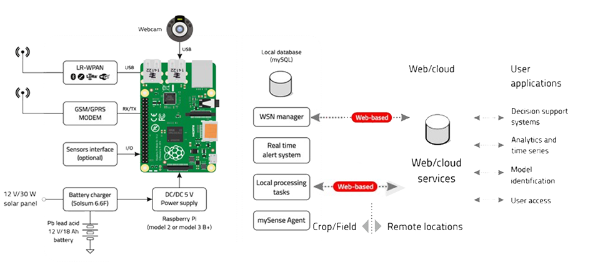
Hardware and Technology Stack
Software Technology
Python & R-programing
Logistic and Neural Network Algorithm
Jupyter Notebook & R-studio Environment
TensorFlow, Keras & SciKit Learn Frame Work
Computer vision, Convolution Neural network
Amazon Web services and Mondo DB
Data from “INDIAN METROLOGICAL DEPARTMENT”

Slide 10
Thank you

